Slide 1

Skill Lab Project
DEPARTMENT OF COMPUTER SCIENCE AND ENGINEERING
SILICON INSTITUTE OF TECHNOLOGY
Submitted by:
Debidutta Dash(180310359)
Anish Sinha (180310364)
Yash Panda(180310440)
Swapnosanjog Mohanty(180310202)
Under the esteemed supervision of:
Mr. Dayal Kumar Behera
Mr. Jiten Mohanty

Slide 2
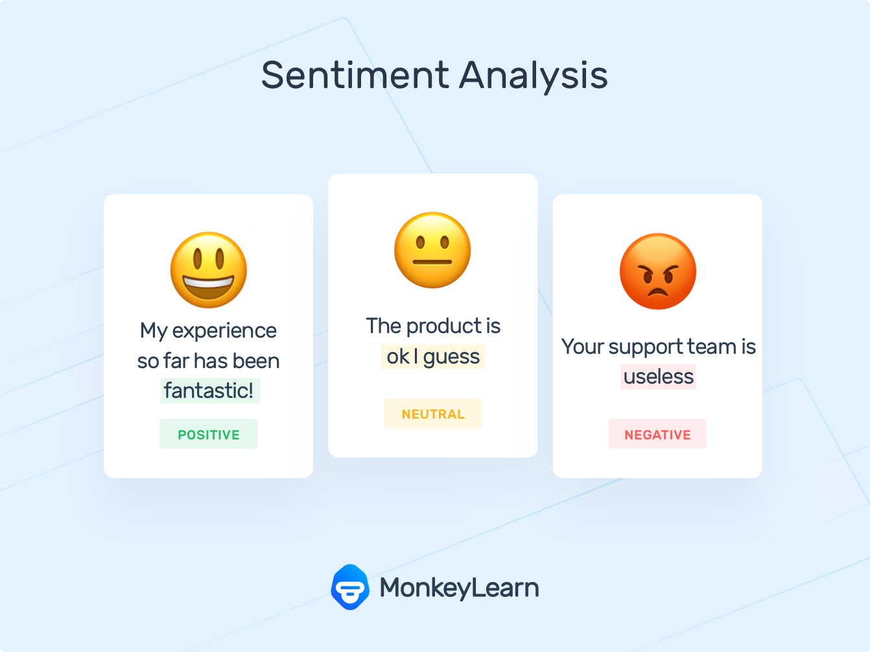
Product Review Analysis
A sentiment analysis based opinion gathering project for products listed on Amazon

Slide 3
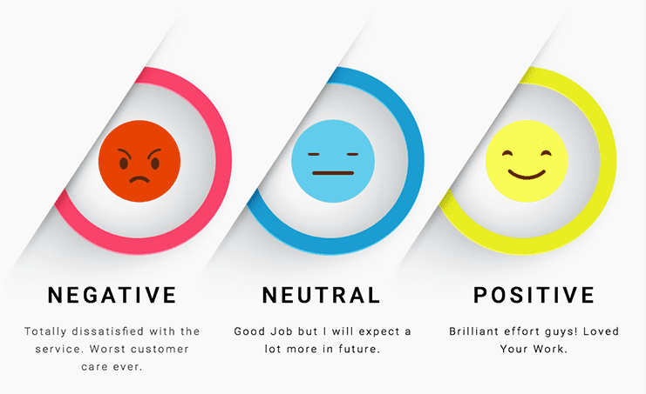
Need
Product is out there in the market with millions of reviews
Finding out ‘what’ is wrong with the product can help improve it
Business Perspective of review analysis:
Customer Sentiment
Information Gathering
Brand Tracking
Monitor Reviews

Slide 4











Project Flow
Feature
Engineering
Transform to word embedding models
Scrape data from amazon
Hyperparameter tuning
Training
1. LSTM
2. XGBoost
3. Naïve Bayes
Visualisation
&
Inferences
4. Decision tree
Graphical Interface
Make predictions
Model loading

Slide 5
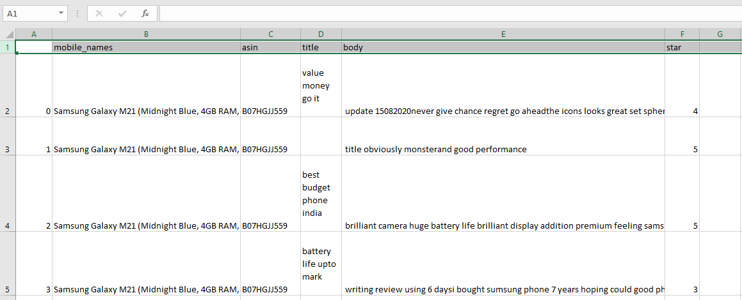
Dataset
The entire dataset is generated gradually by scraping various product reviews from Amazon Website

Slide 6
To scraping notebook ---->>

Slide 7




Stack and Libraries used
Streamlit – GUI
Keras + Tensorflow – LSTM, ANN
Scikit Learn – Decision Tree, Naïve Bayes
Plotly – charting

Slide 8
Models and Accuracy
Model | Accuracy Score
LSTM(Long Short- Term Memory) Recurrent Neural Network | 0.983
XGBoost Regressor | 0.994
Decision Tree Classifier | 0.995
Naïve Bayes Classifier | 0.409

Slide 9
Methodology
Accepted
Discarded
Word Embedding feature extraction using GloVe word dictionary is chosen.
Accepted models are:
LSTM(Long Short Term Memory model)
XGBoost Regressor
Decision Tree Classifier
(Naïve Bayes classifier, although performed poorly, is still incorporated)
The classical approach of feature engineering involving Count vectorization and TF-IDF methods are excluded as it resulted in extremely poor performance.
ANN(Artificial Neural Network) model is discarded due to poor accuracy.
VADER (pre trained model) is not incorporated as it performed poorly while analyzing multiple sentences in a review.

Slide 10
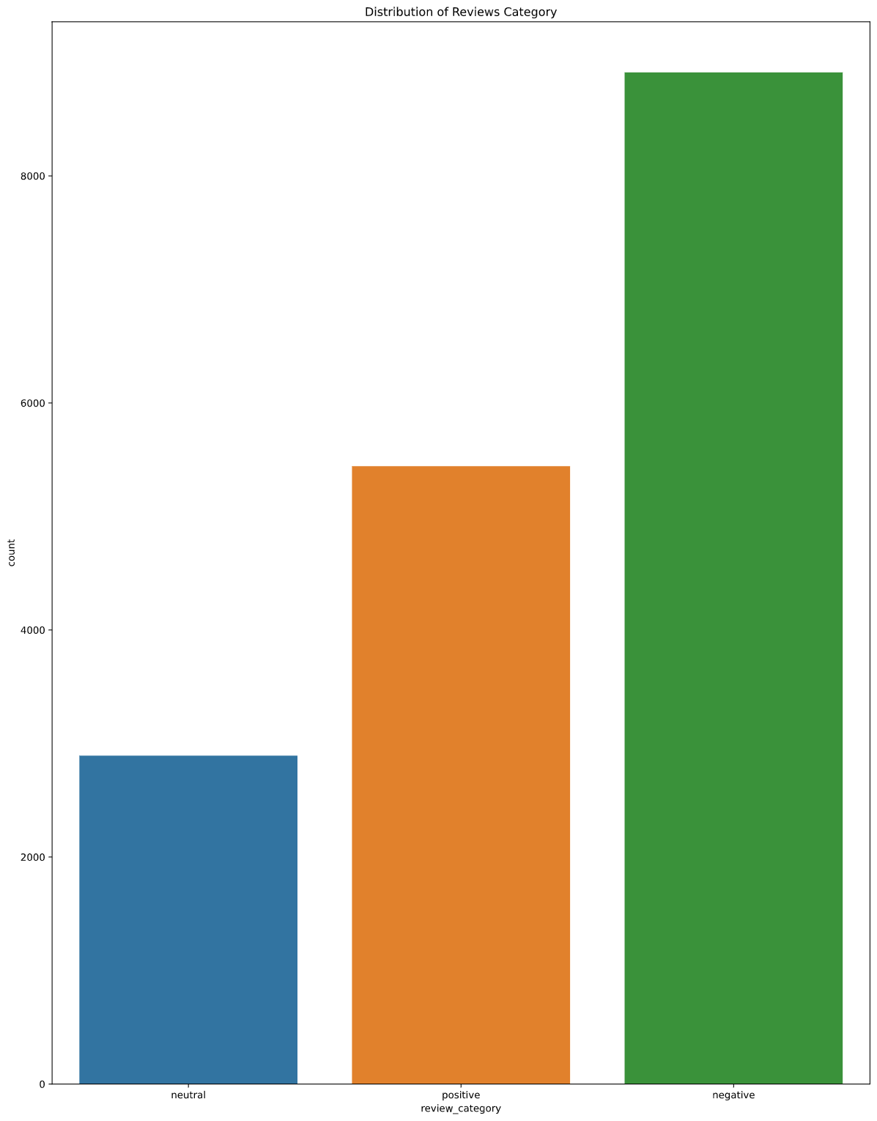
Inferences 1
The sentiment distribution bar plot showed how much the product is adorned by the people.

Slide 11
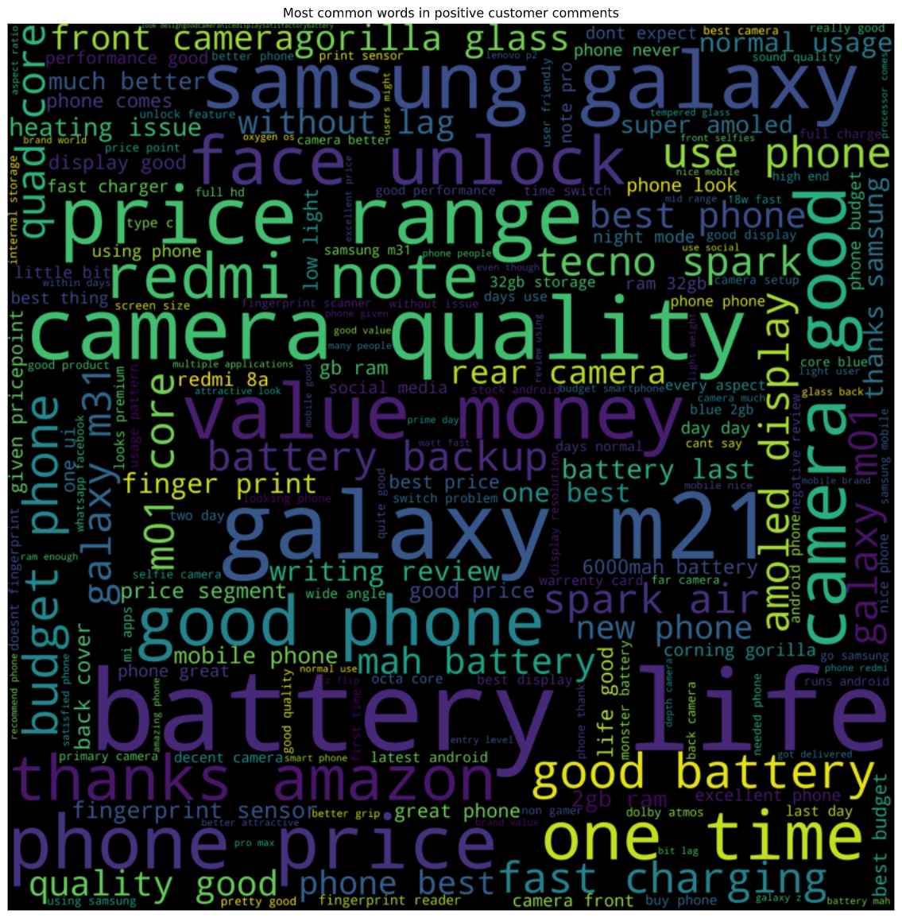
Inferences 2
A unigram plot :- WordCloud
Shows frequent words in the positive reviews

Slide 12
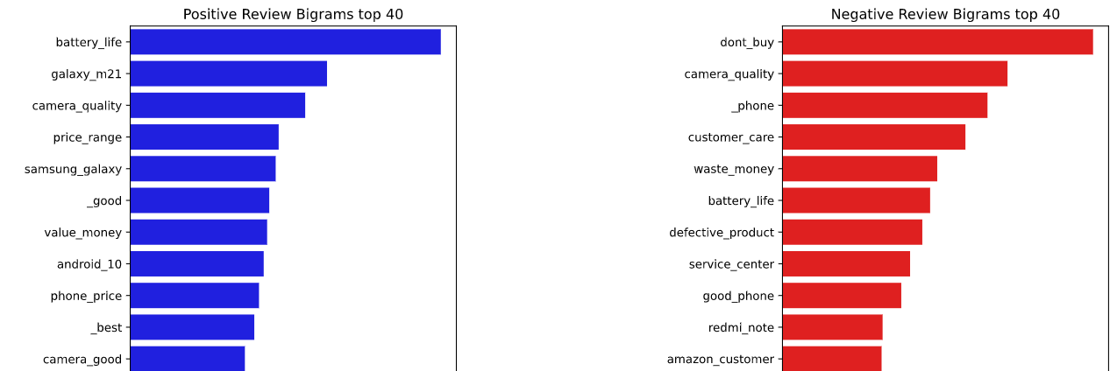
Inferences 3
Shows the most commonly used bi-grams in the reviews

Slide 13
Model Training and GUI
The GUI was made using Streamlit library
Streamlit is an open-source app framework for Machine Learning and Data Science teams. Create beautiful data apps in hours, not weeks. All in pure Python

Slide 14
To training notebook and GUI ---->>

Slide 15
Challenges
Preparing the dataset on real reviews from amazon was the most challenging
Too many GET requests to amazon for scraping the reviews might lead to blocking of IP.
Aspect level sentiment analysis is required, but performing it on a huge dataset for NER(Named Entity Recognition) gathered garbage results.
Selecting appropriate feature engineering technique was a hard job to determine.
Model performance on a foreign dataset for product review deteriorates to an appreciable extent.
Combining a word embedding model with a machine learning model (for example VADER + Decision Tree) produces best results as cited on research papers, but implementing it became challenging.
Limited knowledge of NLP was the biggest hindrance.
Streamlit library used for GUI, is a relatively new library and many features are in development.
Loading and predicting so many models at a time in a GUI, without a GPU in the PC , made it to run slowly. Had a hard time debugging while adding functionalities to the GUI.

Slide 16
Future Scope
Automate the scraping part for a product once enlisted in the database for review analysis
Integrate the models to a better GUI and create an API for using it.
Integrate the scraping part into the GUI
Perform real time review analysis for a product and provide reports to the user
Find better methods to understand reviews in a human-alike manner

Slide 17
Conclusion
The best model in terms of training accuracy was Decision Tree classifier with an accuracy score of 0.995
On the given dataset some inferences drawn for the product (Samsung Galaxy M21) are:
Positive:
battery_life(people are liking the large battery life of the product)
value_for_money (budget phone)
camera_quality
Negative:
service_center (might be issues relating to Samsung service centers)
customer_support (poor customer support of Samsung)
defective_product
From the above, efforts can now be made to improve the product.

Slide 18
Thank You
References:
Stanford NLP (link)
Andrew Ng’s Sequence models on Coursera (link)
Zolzaya Luvsandorj article in medium for pre- trained NLP models (link)
Fine-grained Sentiment Analyis by Prashanth Rao on medium (link)
Scraping tutorials by on YouTube by John Watson Rooney (link)

